Slide 1
Protection of functional groups and planning organic synthesis
1- Introduction of protected groups
a) Protect and cleavage ( deprotect) of carbonyl compounds
b) Protect amine and phenol
c) Protect carboxylic group
2- Oxidation and reduction
3- Planning organic synthesis
Introduction of design organic synthesis
Basic concepts of retrosynthesis analysis
Transform-based strategies
Structural and topological - based strategies
Approach disconnect
Application and examples

Slide 2
Protecting Carbonyl Groups
Protect ketone and aldehyde as cyclic and acyclic ketal and acetal Stable to base and remove with acid
The most useful protective groups are the acyclic and cyclic acetals or ketals,
and the acyclic or cyclic thio acetals or ketals. The protective group is introduced
by treating the carbonyl compound in the presence of acid with an alcohol, diol,
thiol, or dithiol.
Cyclic and acyclic acetals and ketals are stable to aqueous and nonaqueous bases,
The carbonyl group forms a number of other very stable derivatives that are
less used as protective groups because of the greater difficulty involved in their
removal. Such derivatives include cyanohydrins, hydrazones, imines, oximes,
and semicarbazones.

Slide 3
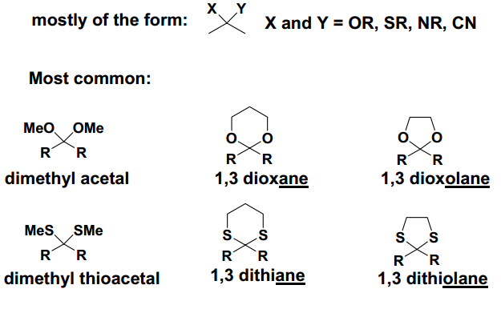
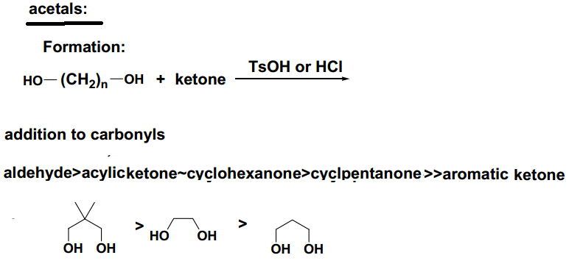

Slide 4
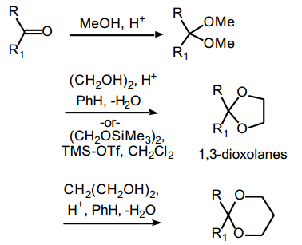

Slide 5
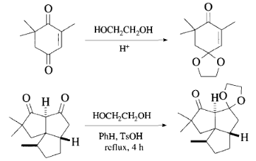
Why

Slide 6
Dithio Acetals and Ketals
A carbonyl group can be protected as a sulfur derivative—for example, a dithio
acetal or ketal, a 1,3-dithiane, or a 1,3-dithiolane—by reaction of the carbonyl
compound in the presence of an acid catalyst with a thiol or dithiol. The derivatives are, in general, cleaved by reaction with Hg(II) salts or oxidation
acidic hydrolysis is unsatisfactory.
RSSiMe3 , R= Me
Cyclic Dithio Acetals and Ketals

Slide 7
Substituted Hydrazones
N,N-Dimethylhydrazone: RR'C=NN(CH3)2
H2NNMe2, EtOH-HOAc, reflux, 24 h,
Phenylhydrazone: C6H5NHN=CR2 and derivatives
PhNHNH2, AcOH, EtOH.
2,4-Dinitrophenylhydrazone
phenylhydrazones are cleaved by various oxidizing and reducing agents, and
by exchange reactions.
Tosylhydrazone: CH3C6H4SO2NHN=CR2
Cleavage
Formation
TsNHNH2,AcOH,EtOH.
Dimethyldioxirane, acetone,
t-Butyl hydroperoxide, CC14, Cleavage is effective only for aromatic tosylhydrazones.

Slide 8
Semicarbazone:
(NH2CONHN=CR2)
Formation : NH2CONHNH2, NaOAc, MeOH.
Cleavage : Pyruvic acid, acetic acid, CHC13, or CuCl2-2H2O, CH,CN, reflux,
Oxime Derivatives: R2C=NOH
Formation : H2NOH-HC1, Pyr, 60°.
This is the standard method for the preparation of oximes. Ethanol or methanol
can be used as co solvents.
Cleavage
Oximes are cleaved by oxidation, reduction, or hydrolysis in the presence of
another carbonyl compound.
0-Methyl Oxime: R2C=NOCH3
Formation : MeONH2HCl, Pyr, MeOH,

